Slide 1
Capstone Project-1
Play Store App Review Analysis
By
Ganapathi Kakkirala

Slide 2

Let us draw some insights:
Business Problem
Objective
Analysing the datasets
EDA on Play Store Apps Data
Data Cleaning
Data Manipulation
Univariate Analysis
Bivariate Analysis
Analysis on User Reviews Data
Answering Key Business Questions
Conclusion
Q&A

Slide 3


Business Problem Overview
Android apps have almost 70% of the market share in the whole app market pushing back the IOS and other platforms. It comes with the huge potential to drive massive profits to the developers if users appreciate it. The Play Store apps data has enormous potential to drive app-making businesses to success. Hence, It is important for the developers to get the useful insights regarding the user preferences.

Slide 4
Objective
Understanding the Paid and Free app markets in the play store data.
Finding the most popular and downloaded app categories.
Looking into the correlation between variables.
Demystifying the top paid apps and the analysing their prices and revenue.
Diving deep into the user ratings and comparing across the categories.
Understanding the preferences of the users and suggesting what works well in paid and free app markets.

Slide 5
Data Summary
The play store reviews dataset consists of 13 columns and 10841 rows. These columns in the dataset gives different information about each app,
App (Name of the app)
Category
Ratings
Reviews
Size
Installs
Type
8. Price
9. Content Rating
10. Genres
11. Last Updated
12. Current Ver
13. Android Ver

Slide 6

Data Manipulation
During the analysis, we have created three new columns to dive deep into the paid apps market. Hence the two columns created were,
Price_in_$
Estimated_Base_Revenue_in_$
Rating_Description

Slide 7
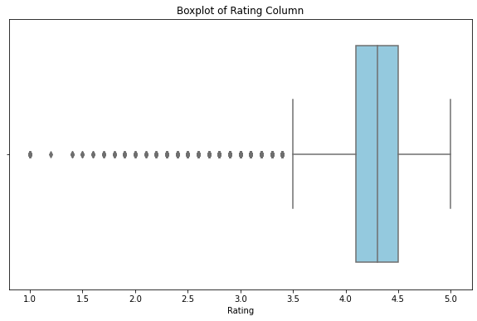
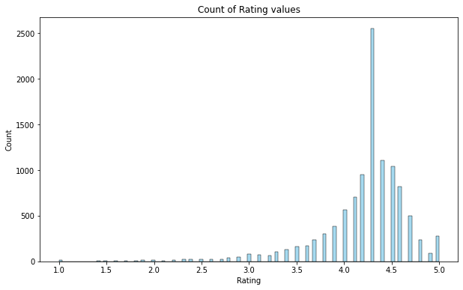
The Median rating is 4.3
Notes:
Median imputed NaN values

Slide 8
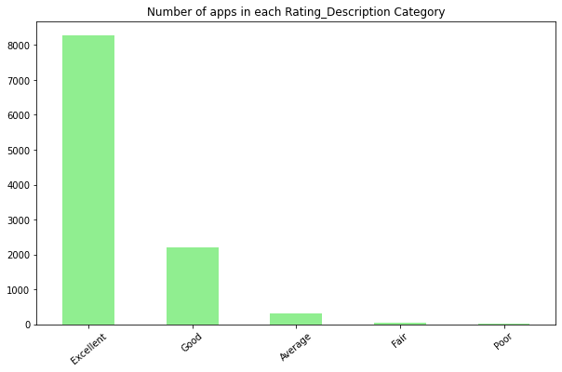
8000+ Apps Got Excellent Rating
Observation:
8000+ apps got 4+ ratings
2200+ apps got ratings between 3-4

Slide 9
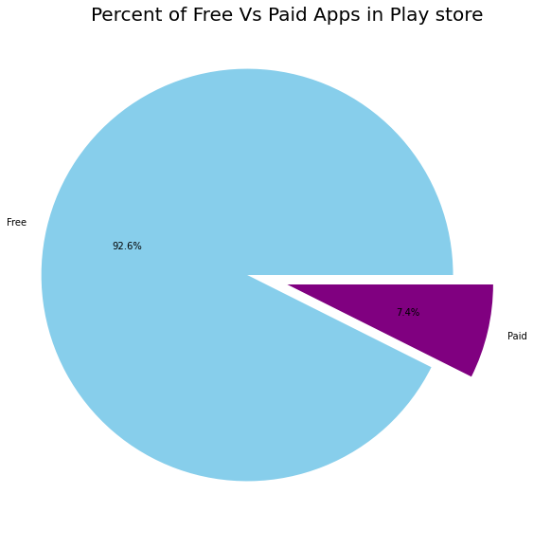
92.6% Android apps are available for Free
Observation:
Google runs android for free as their business model involves running targeted ads in the user’s devices. So the scope for paid apps in android market is not significant

Slide 10
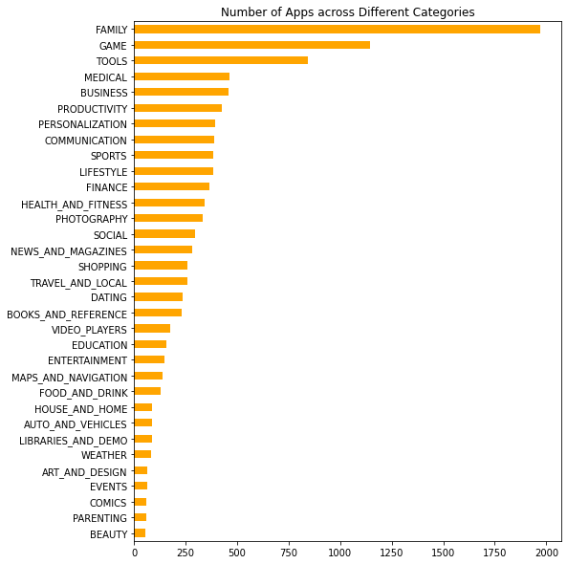
Top Categories in the App Market
Observation:
The Category "Family" tops the list with nearly 2000 apps
"Beauty" category is the least prominent one with close to just 50 apps.
Categories like Gaming and Tools also have significant user base.
Art and Design, Events, Comics and Parenting were some of the low performing categories.

Slide 11
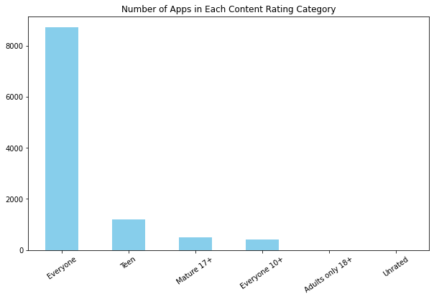
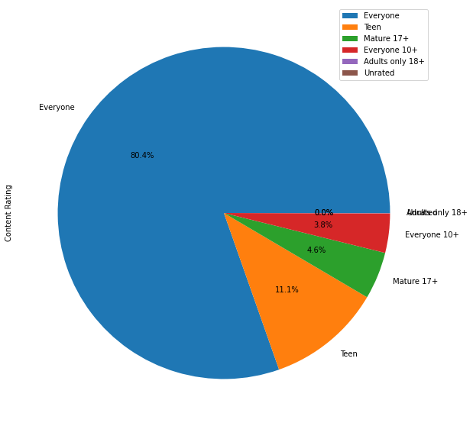
80.4% apps have No Age restriction to use.

Slide 12
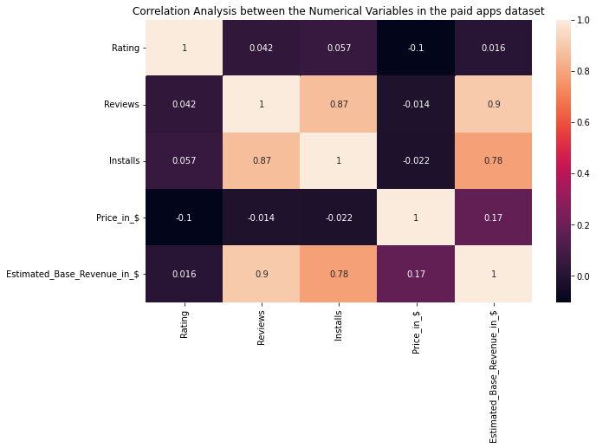
Reviews Influence Revenue by 90% !!
Observations:
In the paid app market, we can observe a strong correlation between Reviews and Installs of 0.87, Also, estimated revenue is very highly correlated with the reviews with a correlation coefficient of 0.9
Similarly Estimated revenue and Installs are 78% correlated.
It indicates that user reviews play a significant role in the growth of a paid apps.

Slide 13
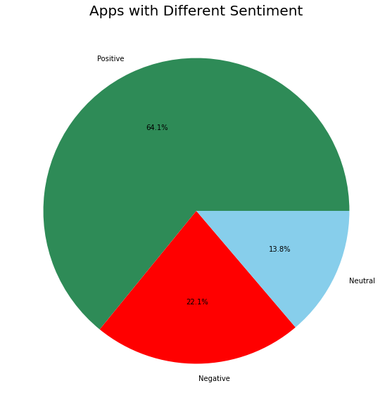
22% of the reviews are Negative.
Observation:
It is good to see that 64% apps reviews got completely positive reviews and 13.8% neutral reviews.
Around 22.1% apps god serious issues with them and probably the developers should look into these negative reviews.

Slide 14
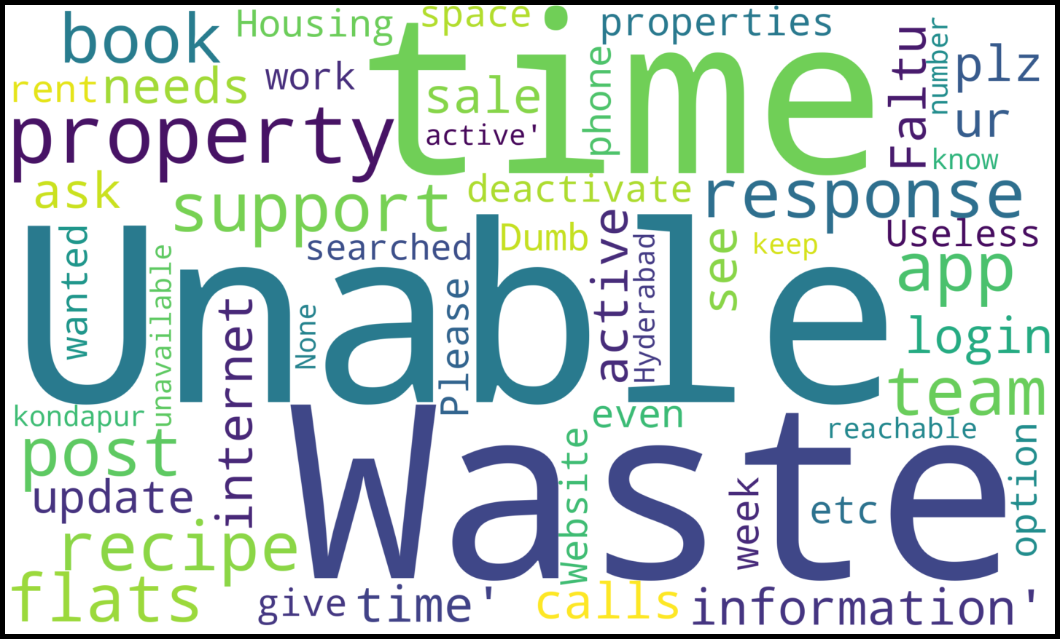
What does these Negative reviews contain?

Slide 15

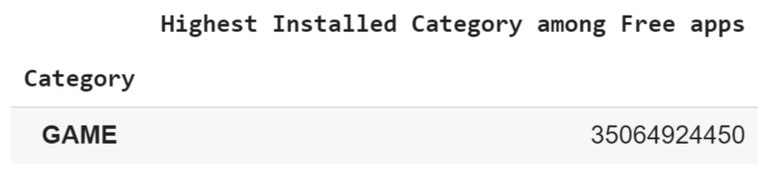
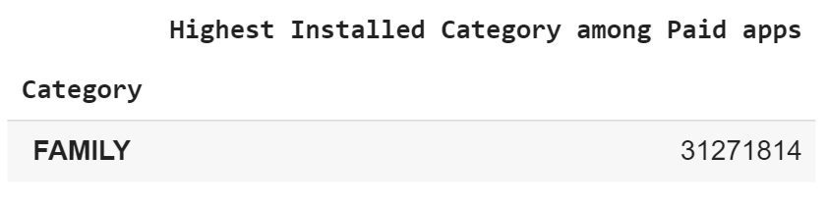
Let us answer these Key Questions:
Which Category has the Highest Installs among Paid and Free apps?
Observations:
Obviously as anticipated we have Gaming category with a whooping 35B+ installs across the category.
On the other hand paid apps has Family Category with 31M+ downloads

Slide 16
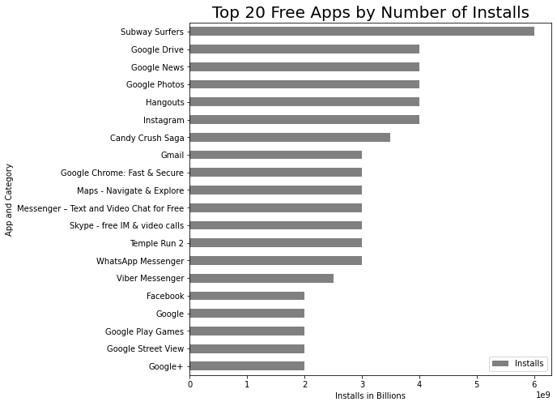
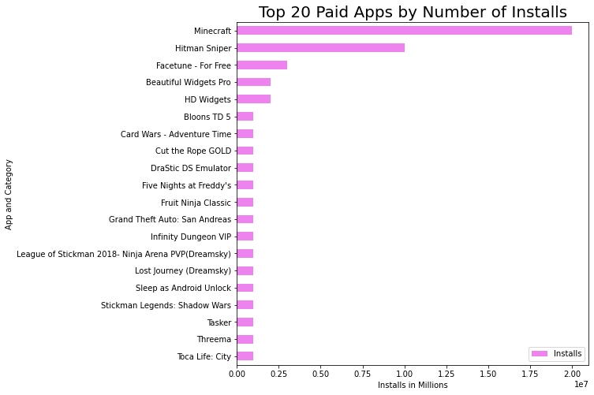
Which apps has the highest installs among paid and free?
Google and FaceBook ecosystem dominating the free app market along with some popular games
Minecraft game has 2 Million + installs in the paid app market making it the most downloaded paid app.

Slide 17
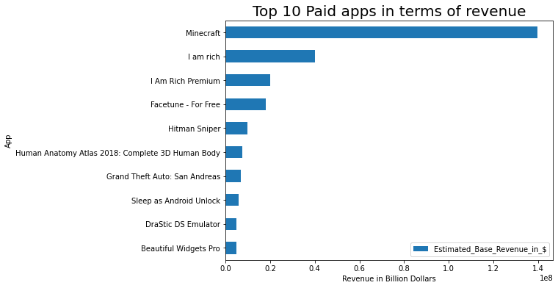
Which are the top 10 profitable paid apps?
Observation:
Minecraft has highest revenue with 1.4 B dollars.
Next comes I am rich with total revenue of 400M dollars
Also there are other gaming apps in the top 10 list.

Slide 18
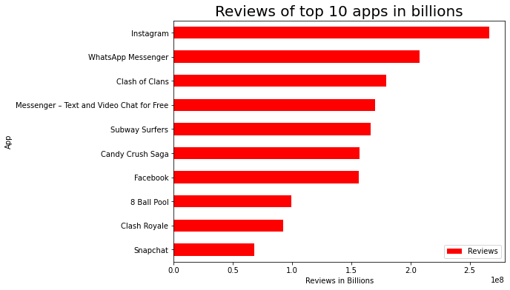
Find the most popular apps in the market, Infer some reasons for popularity.
Observations:
The FaceBook ecosystem which is the social media giant containing Instagram,Facebook, Whatsapp and Messenger beats the Google apps in terms of user reviews.
Next comes few popular apps like Subway Surfers, Candy Crush, Clash of Clans, 8 Ball pool and Clash Royale.

Slide 19
Conclusion:
Free apps dominate the android market with a share of 92.6% . So developers can tap this huge user base if they managed to release their apps for free.
In the paid app market, 0.99$ to 2.99$ is accepted well, So anyone trying to launch a paid app can pick a price in this range.
Tech giants like Facebook and Google hold the top position when it comes to the number of installs. On the other hand Facebook being a social media platform disrupted the android market with Instagram, Whatsapp in its family. These popular apps though available for free but make huge money by running targeted ads.
Paid app market is highly influenced by the user reviews as we have seen 87% correlation between reviews and Installs and 90% correlation between reviews and Estimated revenue.
Minecraft managed to get lots of users even being a paid app. It is observed that users pay for games more than any other apps.

Slide 20
Thank You

